Slide 1
Market Magician Algorithmic Trader
Artificial Asynchrony
CS691
Nov 2024

Slide 2
Agenda
✅
Team Roles and Responsibilities
*Professor Feedback
Problem Statement
Project Description
Project Schedule
Team Working Agreement
Personas
MVP
Technologies
Algorithms
*Diagrams
*Sprint 1 Recap
*Product Backlog
*Sprint 2 Backlog
*Metrics
*Retrospective
*Sprint 3
*Project Demo
Wikipage Link
Notes:
Green check mark = updated slide

Slide 3
Roles and Responsibilities
Kassandra Camarillo – Team Leader
Henry Kim – Scrum Master
Abed Mussawi – Developer
Andrew Rowan – Developer
Aviel Sánchez - Developer
Notes:
Blue x mark = layout change only

Slide 4
Feedback Summary
✅
User Story Acceptance Criteria too vague
Updated all AC following professor’s feedback
Story points need to be estimated in Fibonacci
Re-pointed stories with Fibonacci and a reference story
Sprint Backlog slide text too small
Split up slides for legible text
Slide design lacking polish, and missing slides
Cleaned up images
Followed presentation checklist more closely
Notes:
Kassandra

Slide 5
Problem Statement
Currently, there is a lot of interest in the stock market. Sometimes it could be confusing and daunting to invest money in the stock market since there is a lot of information and it is difficult to access. Our application will make it much easier and more accessible to the greater public to invest more wisely and with the power of data at their back.

Slide 6
Project Description
An AI that uses historical data, news flow, and intra-day trading data to determine entry and exit points of a stock or fund using a trained regression model in order to maximize profits.
This is for Daily traders and Investors
who want to improve predictive capabilities,
the webb App is a tool to help both large and small capital investors and traders predict market trends faster than a human could.
This subscription service unlike hedge funds, where you need to pay a lot of money out of pocket to manage your investments, or risk trading personal funds with untested strategies,
our application provides an easy way to invest and trade your securities to minimize risk and maximize profits

Slide 7
Project Schedule
Meeting Cadence
Twice a week (Mon, Thur)
Additional meetings scheduled ad hoc based on team needs
Text Based Daily Scrum
Asynchronous team makes daily scrums impractical
Substitute with text based check in

Slide 8
Team Working Agreement
Scheduling meetings
Communications
Technologies used
Tentative schedule
Respect
Notes:
No mark, no change

Slide 9

Alex Woods - Retail Investor
Age: 23
Location: Arlington, Virginia
Occupation: Nurse / recent graduate
Alex is a recent graduate who wants to start investing but has limited money and a bit of experience. She is looking for an affordable and user friendly platform that can help her enter the investment world without the need for deep financial knowledge.
Using our app will offer her personalized and ease to use market data which will make investing more accessible for beginners like Alex.
Notes:
Abed

Slide 10

Jaylen Washington - Financial Advisor
Age: 33
Location: Austin, Texas
Occupation: Financial Advisor
Jaylen is a financial advisor who assists individuals with decisions about their money. He offers advice on investments, taxes, and insurance.
Using our app will offer him a useful analysis tool that supplements his advisement strategy with AI backed assessments. This could cut down on his research and analysis, saving time and money.
Notes:
Abed

Slide 11

James Smith - Hedge Fund Manager
Age: 35
Location: San Francisco, California
Occupation: hedge fund manager
James is an experienced hedge fund manager and is always on the look up for new and innovative tools to enhance his investment strategies. James understands that now a days AI models are important tools and are more efficient than using traditional methods.
Using our app will offer him cutting edge algorithms and data analysis which can be a great asset to a better investment in combination with his expertise.
Notes:
Abed

Slide 12
Minimum Viable Product
The most important capability of the application is the stock price prediction
This prediction relies on a good model
Therefore, MVP for Market Magician must do the following
Train a model based on selected stock price history
Predict future prices for selected stock
Notes:
Henry

Slide 13
Technologies
Python
JavaScript
Machine Learning
TensorFlow
Keras
Django
HTML
CSS
Reactjs
PostgresSQL
Y!finance
Github
VSCode
Notes:
Andrew

Slide 14
Algorithms
Linear Regression
Poor Prediction Capabilities
Long-Short Term Memory
Needs Activation Function
Monte Carlo
Continue research on implementation
Notes:
Andrew

Slide 15
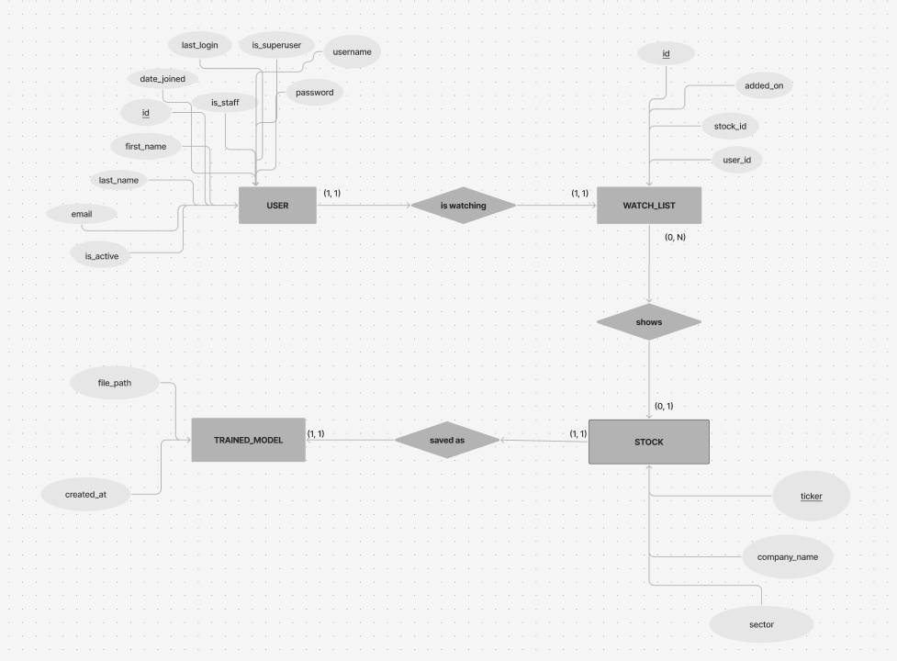
Entity-Relationship Diagram
✅

Slide 16
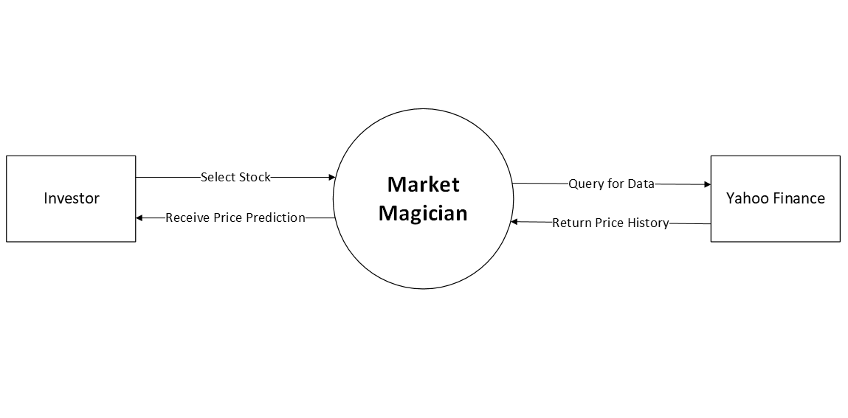
Context Diagram

Slide 17
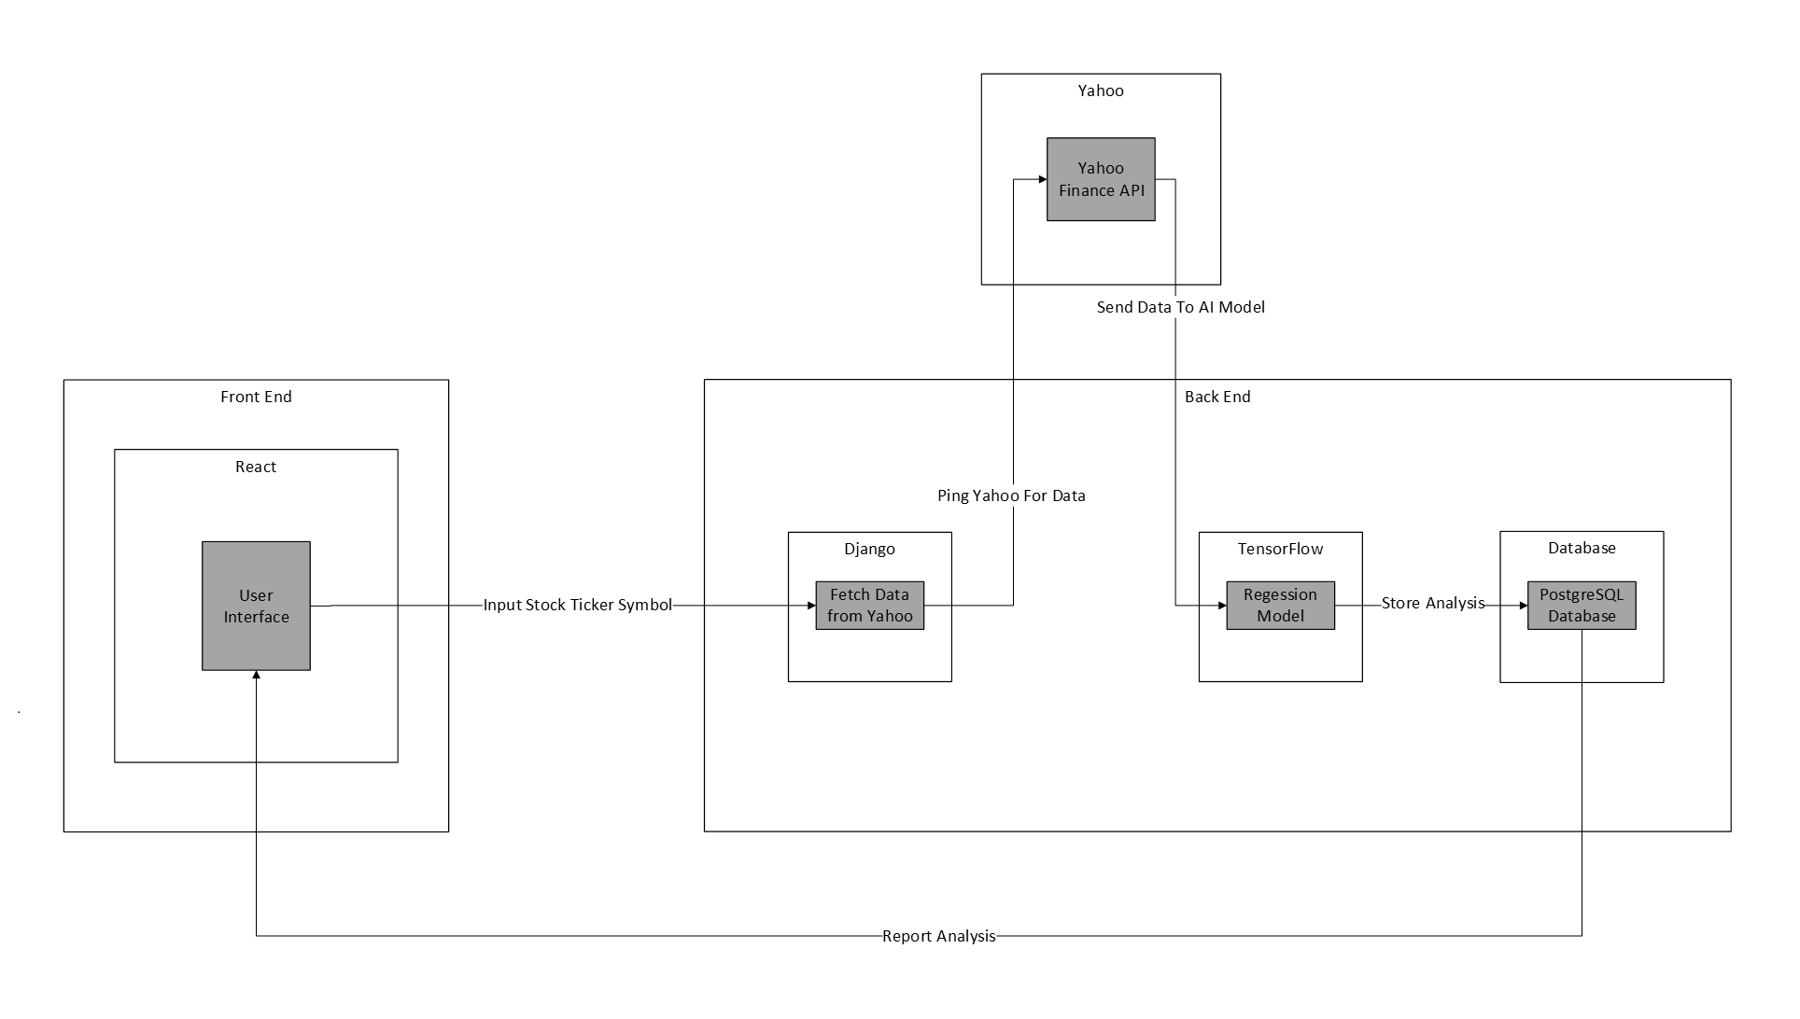
Architecture Diagram

Slide 18
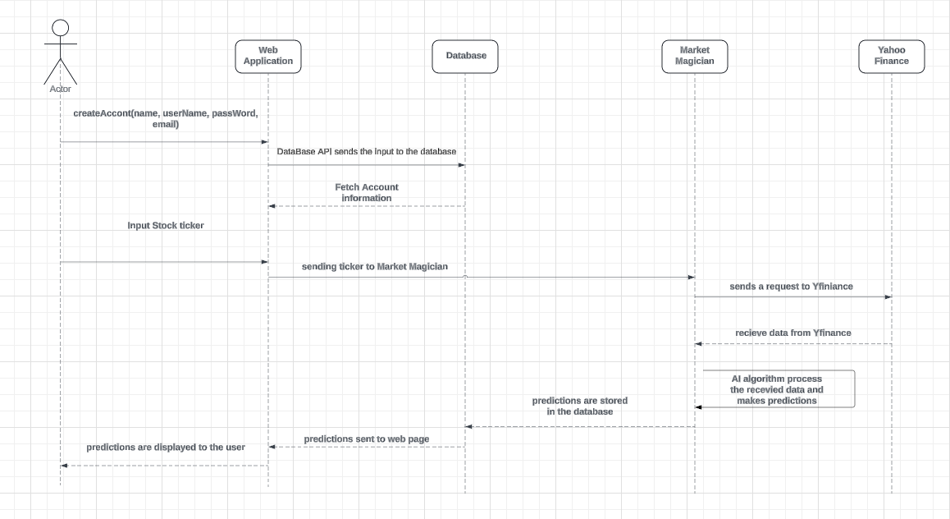
Sequence Diagram

Slide 19
Sprint 1 Recap
✅
Created System Diagrams
Implemented MVP for application
Front end React application
Back end Django framework
AI Model for stock price prediction

Slide 20
Product Backlog
✅
Product Backlog updated following User Story design feedback
Larger stories split into smaller ones
New stories added to capture more features
Notes:
Henry

Slide 21
Product Backlog cont.
✅
Issue Type | Issue key | Summary | Assignee | Status | Resolution | Description | Custom field (Acceptance Criteria)
Story | MARKETMAG-37 | Receive stock recommendations |  | To Do |  | *As a/an* retail Investor, *I Want to* receive stock recommendations, *So that* I can consider my potential investments | # User presented with list of stock recommendations
Story | MARKETMAG-38 | See investment overview |  | To Do |  | *As a/an* retail Investor, *I Want to* see a simple overview of my investments and their performance, *So that* I can monitor my account’s performance | # Application displays stocks in my account and shows their performance history
Story | MARKETMAG-39 | Get price prediction for a stock preset and displayed on the stocks page | Aviel Sánchez | Done | Done | *As a/an* retail investor, *I Want to* get a price prediction from a preset stock on the stocks page, *So That* I can decide if I wish to buy, sell, or hold that stock | # In the stocks page, when a user clicks one of the displayed stocks, the application will present a price prediction along with recent price trends in a line chart

Slide 22
Product Backlog cont.
✅
Issue Type | Issue key | Summary | Assignee | Status | Resolution | Description | Custom field (Acceptance Criteria)
Story | MARKETMAG-40 | Personal and financial data must be secure (needs another look) |  | To Do |  | *As a/an* retail investor, *I Want to* know that my personal and financial data are securely handled, *So that* I can trust the app with sensitive information
Story | MARKETMAG-41 | Search for stocks other than those saved in "stocks" page | Henry Kim | Done | Done | *As a/an* retail investor, *I Want to* select a stock other than the presets in the stocks page, *So That* I can get price predictions from other stocks beside the presets | # In the search page, user can enter a stock ticker not displayed in the stocks page
Story | MARKETMAG-42 | View historical price data |  | To Do |  | *As a/an* retail investor, *I Want to* to see historical price data of a selected stock over a range of time I can specify, *So that* I can see price performance in that time range | # User can select an option to see historical data for a stock # The application allows the user to select a range of time # Application displays a line graph of price history within the time range

Slide 23
Product Backlog cont.
✅
Issue Type | Issue key | Summary | Assignee | Status | Resolution | Description | Custom field (Acceptance Criteria)
Story | MARKETMAG-43 | Save data visualizations |  | To Do |  | *As a/an* end user, *I Want to* save off displays and charts the applications has shown me, *So that* I can review them at a later time | # Application offers users an option to save the charts displayed to the user # User can chose to save it to their account or to their local environment
Story | MARKETMAG-44 | See confidence metric of model's predictions |  | To Do |  | *As a/an* retail investor, *I Want to* see what the confidence intervals are for the predicted price, *So that* I can determine how accurate the prediction might be | # User sees the 95% or 99% confidence interval for the selected stock
Story | MARKETMAG-45 | Select the time window to train a stock model |  | To Do |  | *As a/an* retail investor, *I Want to* Select the time window to train a stock model, *So that* I can tailor the price predictions to my personal preferences | # Users can select a time range via slider bar or date range to train a stock model # The application displays the settings were saved for the model they are trying to train

Slide 24
Product Backlog cont.
✅
Issue Type | Issue key | Summary | Assignee | Status | Resolution | Description | Custom field (Acceptance Criteria)
Story | MARKETMAG-47 | Create user account/profile | Kassandra Camarillo | To Do |  | *As a/an* new user, *I Want to* create a user account with my own login name and password, *So that* I can securely log into the application | # When a user at the sign up page enters a unique account name and secure password in the account creation form, the application displays confirmation of account creation. # If and error occurs (name is not unique or password does not meet security minimums) display error to the user and ask to try again
Story | MARKETMAG-48 | Sort stock watchlist |  | To Do |  | *As a/an* retail investor, *I Want to* quickly sort and search through my watchlist based on price, trend, name, etc., *So that* I can easily see which stocks have been performing well/poorly quickly | # User can sort through their watchlist based on options provided by the application (such as current price, name, confidence)

Slide 25
Product Backlog cont.
✅
Issue Type | Issue key | Summary | Assignee | Status | Resolution | Description | Custom field (Acceptance Criteria)
Story | MARKETMAG-61 | Create watch list page | Andrew Rowan | To Do |  | *As a* retail investor, *I Want* a webpage where I can add stock tickers to a watchlist, *So that* I can easily track my personal stock interests | # Users can navigate to a watchlist page when clicking on the watchlist link on the home page # Users can navigate back to the home page when clicking on the home page link on the watchlist page
Story | MARKETMAG-69 | Create home page for user to navigate application | Kassandra Camarillo | Done | Done | *As a/an* retail investor, *I Want* a homepage, *So that* I can select where I can navigate to from the homepage | # When a user goes to the homepage, there will be links for the user to select to get to other pages
Story | MARKETMAG-70 | Train AI models for stocks of interest | Andrew Rowan | In Review |  | *As a/an* retail investor, *I Want to* create AI models for stocks I’m interested in if they are not already in the application, *So That* I can use the model to predict prices | # When user has a stock selected that does not have an existing model, a training option will appear # When the training option is clicked, the application will train a new model and save it

Slide 26
Product Backlog cont.
✅
Issue Type | Issue key | Summary | Assignee | Status | Resolution | Description | Custom field (Acceptance Criteria)
Story | MARKETMAG-72 | Create stocks page | Jonathan Sanchez | Done | Done | *As a* retail investor, *I Want* a webpage where I select stocks , *so that* I can train models and get price predictions | # When the user clicks on the stocks link, the browser should navigate to the stocks page # When the user clicks on home page link, the browser should navigate back to the hope page
Story | MARKETMAG-73 | Create login page | Kassandra Camarillo | Done | Done | *As an* application user, *I Want* a webpage where I can enter my user credentials, *so that* I can securely log into my account | # When the user clicks on the login link the browser should navigate to the login page # When the user clicks on the homepage link, the browser should navigate to the home page
Story | MARKETMAG-74 | Create sign up page |  | To Do |  | *As an* application user, *I Want* a sign up webpage, *so that* I can create a new user account | # When the user clicks on the sign up link, the browser should navigate to the sign up page # When the user clicks on the homepage link, the browser should navigate to the home page

Slide 27
Product Backlog cont.
✅
Issue Type | Issue key | Summary | Assignee | Status | Resolution | Description | Custom field (Acceptance Criteria)
Story | MARKETMAG-75 | Check for existing models | Abed Nael Mussawi | Done | Done | *As a/an* experienced investor, *I Want* to be prompted if a stock I chose has no existing model, *So that* I can decide if I want to wait to train a model or not | # When user clicks on get prediction for a stock that does not have a model, the application will display a prompt # The prompt will tell users the stock model does not exist Tensorflow models are saved locally in the file system. The database will point to the paths of these models.
Story | MARKETMAG-76 | Add log out function |  | To Do |  | *As a/an* app user, *I Want to* log out from my account, *So that* other people can’t access my account | # When user clicks on the logout button, the application logs the user off # When logged off, user will be redirected back to homepage

Slide 28
Product Backlog cont.
✅
Issue Type | Issue key | Summary | Assignee | Status | Resolution | Description | Custom field (Acceptance Criteria)
Story | MARKETMAG-77 | Save stock to watchlist |  | To Do |  | *As a* retail investor, *I Want* to save a stock to my watchlist in the watch list page, *So that* I can customize and easily track my personal stock interests | # When user enters a valid stock symbol in the watchlist page, it is added to the user’s watchlist table.

Slide 29
Sprint 2 Backlog
✅
Sprint backlog also updated following User Story design feedback
Point estimation updated
Modify points mid sprint affected sprint metrics
Notes:
Henry

Slide 30
Sprint 2 Backlog cont.
✅
Issue Type | Issue key | Summary | Assignee | Status | Description | Custom field (Acceptance Criteria) | Custom field (Work Done)
Story | MARKETMAG-75 | Check for existing models | Abed Nael Mussawi | Done | *As a/an* experienced investor, *I Want* to be prompted if a stock I chose has no existing model, *So that* I can decide if I want to wait to train a model or not | # When user clicks on get prediction for a stock that does not have a model, the application will display a prompt # The prompt will tell users the stock model does not exist # Tensorflow models are saved locally in the file system. The database will point to the paths of these models. | # Added a function to save the model to the local files. # Added a function to load saved files from the local files and implemented both functions in the prediction view. # Developed a Django model that creates a database table where the path to locally saved trained models is stored.
Subtask | MARKETMAG-68 | implement the Django's model to save the paths for TensorFlow models. | Abed Nael Mussawi | Done | Tensorflow models are saved locally in the file system. The database will point to the paths of these models.

Slide 31
Sprint 2 Backlog cont.
✅
Issue Type | Issue key | Summary | Assignee | Status | Description | Custom field (Acceptance Criteria) | Custom field (Work Done)
Subtask | MARKETMAG-54 | Check if Django database(model) can save trained AI stock models | Abed Nael Mussawi | Done | Save model in local memory, django DB hold path information.
Subtask | MARKETMAG-53 | Split up page_test view into model training and get prediction views | Abed Nael Mussawi | Done | Add andrew as cosign
Task | MARKETMAG-34 | Sprint 2 Application Test Cases | Abed Nael Mussawi | Done | # Research how Django implements tests. # Create some component level tests for backend # Set of steps to test front end | # Design tests using Djanjo’s framework to test the functionality of the application # Running these tests and reporting the tests findings # Manually testing the website page, making sure that all the buttons and functionalities operate as intended | # researched Django’s test methodology. # implemented some component-level tests in the test.py file of the project # Manually tested the website and made sure everything is working as intended

Slide 32
Sprint 2 Backlog cont.
✅
Issue Type | Issue key | Summary | Assignee | Status | Description | Custom field (Acceptance Criteria) | Custom field (Work Done)
Story | MARKETMAG-70 | Train AI models for stocks of interest | Andrew Rowan | Done | *As a/an* retail investor, *I Want to* create AI models for stocks I’m interested in if they are not already in the application, *So That* I can use the model to predict prices | # When user has a stock selected that does not have an existing model, a training option will appear # When the training option is clicked, the application will train a new model and save it | # functionality to save and load trained models have been added and to check if the model has already been trained before has been implemented in this story MARKETMAG-75 # Created function to accept a query that automatically trains a model if not already trained # page_test view was separated into page_test and display_prediction views # index.html updated to display a search bar object # Attention function moved to next sprint
Subtask | MARKETMAG-67 | Save LSTM model to local | Andrew Rowan | Done

Slide 33
Sprint 2 Backlog cont.
✅
Issue Type | Issue key | Summary | Assignee | Status | Description | Custom field (Acceptance Criteria) | Custom field (Work Done)
Subtask | MARKETMAG-63 | Add dynamic stock training/predicting in the backedn | Andrew Rowan | Done | Whenever a user wishes to search a stock, it will automatically check if a saved model has been found and if not it will train a model for the user |  | # Created new function if views that separates page_test view and display_prediction view # created new path in urls.py for this new function # updated index.html

Slide 34
Sprint 2 Backlog cont.
✅
Issue Type | Issue key | Summary | Assignee | Status | Description | Custom field (Acceptance Criteria) | Custom field (Work Done)
Story | MARKETMAG-41 | Search for stocks other than those saved in "stocks" page | Henry Kim | Done | *As a/an* retail investor, *I Want to* select a stock other than the presets in the stocks page, *So That* I can get price predictions from other stocks beside the presets | # In the search page, user can enter a stock ticker not displayed in the stocks page | # Created search page with a form that sends ticker string to backed end for processing. # Added APIView functon that validates string against csv of NASDAQ and NYSE stock tickers.
Subtask | MARKETMAG-51 | Decide which elements of the home page we want to implement | Henry Kim | Done | Downselect homepage features for sprint 2. | # Select which features we want to implement for sprint 2 | # Selected navigation features to implement for sprint 2. # Updated story text to reflect the change. Separated other features to other stories.

Slide 35
Sprint 2 Backlog cont.
✅
Issue Type | Issue key | Summary | Assignee | Status | Description | Custom field (Acceptance Criteria) | Custom field (Work Done)
Task | MARKETMAG-71 | Backlog Refinement | Henry Kim | Done | Update sprint and product backlogs to reflect feedback given by the professor. | # Updated sprint backlog # Updated product backlog # Consensus from team | # Updated developer tasks in backlog, moved them as sub-tasks under appropriate user stories # Updated product backlog to have descriptions and acceptance criteria relative to professor’s feedback # Agreement met for reference story marketmag-47 and marketmag-39
Task | MARKETMAG-35 | Link prototype front end and back end | Henry Kim | Done | Application front-end and back-end are currently two separate entities. This task will combine the two code bases into a single project | # React front-end and Django back-end codebases combined into single project codebase # Resolve merge conflicts from all team member code bases # Front end functions successfully interacts with back end using API calls. | # Helped team get all codebases into github repo # Added additional libraries that facilitates React interactivity with Rest APIs # Resolved merge conflicts # Was able to successfully test front end to back end interactivity through API end point and html requests

Slide 36
Sprint 2 Backlog cont.
✅
Issue Type | Issue key | Summary | Assignee | Status | Description | Custom field (Acceptance Criteria) | Custom field (Work Done)
Task | MARKETMAG-33 | Sprint 2 Planning (project task) | Henry Kim | Done | Conduct a planning session for sprint 2. Estimate points for stories/tasks and assign to backlog. | # Initial set of stories and tasks reviewed and accepted by dev team. # Recording of session for project artifact list | # Planning session done in online meeting # Recording created summarizing meeting artifacts in MS Teams

Slide 37
Sprint 2 Backlog cont.
✅
Issue Type | Issue key | Summary | Assignee | Status | Description | Custom field (Acceptance Criteria) | Custom field (Work Done)
Story | MARKETMAG-72 | Create stocks page | Aviel Sánchez | Done | *As a* retail investor, *I Want* a webpage where I select stocks , *so that* I can train models and get price predictions | # When the user clicks on the stocks link, the browser should navigate to the stocks page # When the user clicks on home page link, the browser should navigate back to the hope page | # Implemented react router dom which uses links to navigate through the different pages.
Story | MARKETMAG-39 | Get risk prediction for a stock preset and displayed on the stocks page | Aviel Sánchez | Done | *As a/an* retail investor, *I Want to* get a risk prediction from a preset stock on the stocks page, *So That* I can decide if I wish to buy, sell, or hold that stock | # In the stocks page, when a user clicks one of the displayed stocks, the application will present a price prediction along with recent price trends in a line chart | # MARKETMAG-65 - Converted logos into buttons. Added a loading message and risk prediction functions message # MARKETMAG-66 - Implemented function for risk predictions to communicate between frontend and backend. Also incorporated Abed's save & load functions within backend codebase.

Slide 38
Sprint 2 Backlog cont.
✅
Issue Type | Issue key | Summary | Assignee | Status | Description | Custom field (Acceptance Criteria) | Custom field (Work Done)
Subtask | MARKETMAG-66 | Add backed support for display functions | Aviel Sánchez | Done | Need backend to process request from front end stocks page and send back risk assessments | # Backend processes stocks page sticker via logo buttons and returns risk assessment message. | # Implemented function for risk predictions to communicate between frontend and backend. Also incorporated Abed's save & load functions within backend codebase.
Subtask | MARKETMAG-65 | Add display capabilities to front end stocks page | Aviel Sánchez | Done | Demo stocks page only had logos and preset text. Add actual functionality to logos. | # Turn logos into buttons that sends data. Change preset text to display response data from backend. | # Converted logos into buttons. Added a loading message and risk prediction functions message.
Subtask | MARKETMAG-60 | Decide how were presenting results | Aviel Sánchez | Done | Decide how the stocks page will look | # A Stocks page format | # Review between Avi’s and Kassandra’s stock pages. # Decided to implement Avi’s page, but use Kassandra’s styling.

Slide 39
Sprint 2 Backlog cont.
✅
Issue Type | Issue key | Summary | Assignee | Status | Description | Custom field (Acceptance Criteria) | Custom field (Work Done)
Story | MARKETMAG-73 | Create login page | Kassandra Camarillo | Done | *As an* application user, *I Want* a webpage where I can enter my user credentials, *so that* I can securely log into my account | # When the user clicks on the login link the browser should navigate to the login page # When the user clicks on the homepage link, the browser should navigate to the home page | # Created a log-in page which a user will be directed to when log-in is selected on the navigation bar.
Story | MARKETMAG-69 | Create home page for user to navigate application | Kassandra Camarillo | Done | *As a/an* retail investor, *I Want* a homepage, *So that* I can select where I can navigate to from the homepage | # When a user goes to the homepage, there will be links for the user to select to get to other pages | # Fixed the homepage to display the correct information and added working navigation links to take the user to all different pages.

Slide 40
Sprint 2 Backlog cont.
✅
Issue Type | Issue key | Summary | Assignee | Status | Description | Custom field (Acceptance Criteria) | Custom field (Work Done)
Story | MARKETMAG-47 | Create user account/profile | Kassandra Camarillo | To Do | *As a/an* new user, *I Want to* create a user account with my own login name and password, *So that* I can securely log into the application | # When a user at the sign up page enters a unique account name and secure password in the account creation form, the application displays confirmation of account creation. # If and error occurs (name is not unique or password does not meet security minimums) display error to the user and ask to try again
Subtask | MARKETMAG-62 | Implement home page design updates | Kassandra Camarillo | Done | Planning homepage layout based on initial homepage design. | # Homepage that can navigate between the different frontend pages. | # Created a header with links to each of the application’s pages.
Notes:
Note: create user account/profile carried over to next sprint

Slide 41
Test Cases
✅
Test ID | Story ID | Feature to Test | Test Case | Test Steps | Expected Result | Actual Result | Pass/Fail | Comments
1 | MARKETMAG-75 | SaveTrainedModel | Test the ability to save Trained Models | Navigate to the application root / open a shell / excute django's test command (py manage.py test) | A fake model is created and saved to the specified local directory suing the SaveTrainedModel function | a trained model is saved to local files | Pass
2 | MARKETMAG-75 | LoadTrainedModel | Test the ability to load Trained Models | Navigate to the application root / open a shell / excute django's test command (py manage.py test) | After a trained model is created and saved to locall files we can load it to the application using the LoadTrainedModel function | a model is loaded succefully | Pass

Slide 42
Test Cases cont.
✅
Test ID | Story ID | Feature to Test | Test Case | Test Steps | Expected Result | Actual Result | Pass/Fail | Comments
3 | MARKETMAG-47 | creating users | Testing the ability to create a user and save that user to the database | Navigate to the application root / open a shell / excute django's test command (py manage.py test) | A fake user is created and saved to the database | a user is created and is saved in the database | Pass
4 | MARKETMAG-70 | Accessing Prediction Page | Testing the ability to send a request to the stock prediction page | Navigate to the application root / open a shell / excute django's test command (py manage.py test) | the test should recieve a response from the web page and the response code should be 200 | recieved a response code of 405 | Fail | An HTTP error 405 means that the server configuration refuses access to a resource (URI) due to HTTP method restrictions.

Slide 43
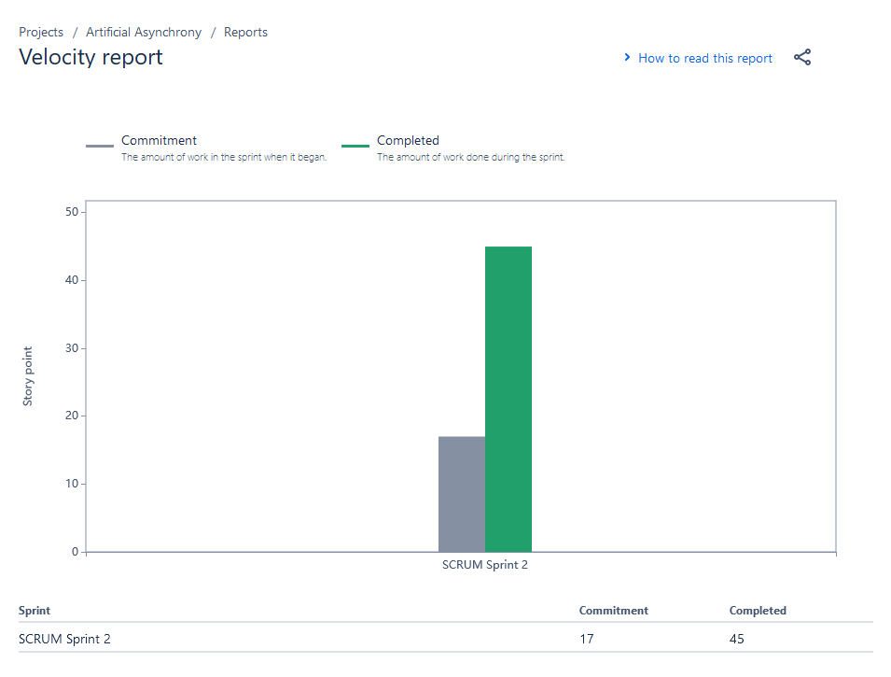
Metrics - Velocity
✅

Slide 44
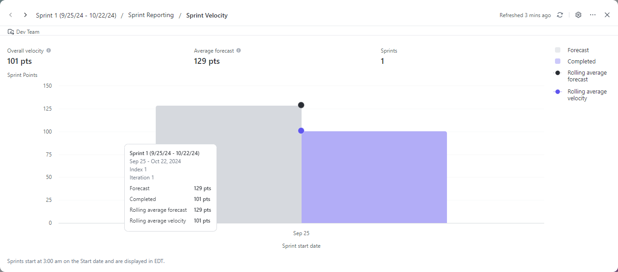
Metrics - Velocity History
✅

Slide 45
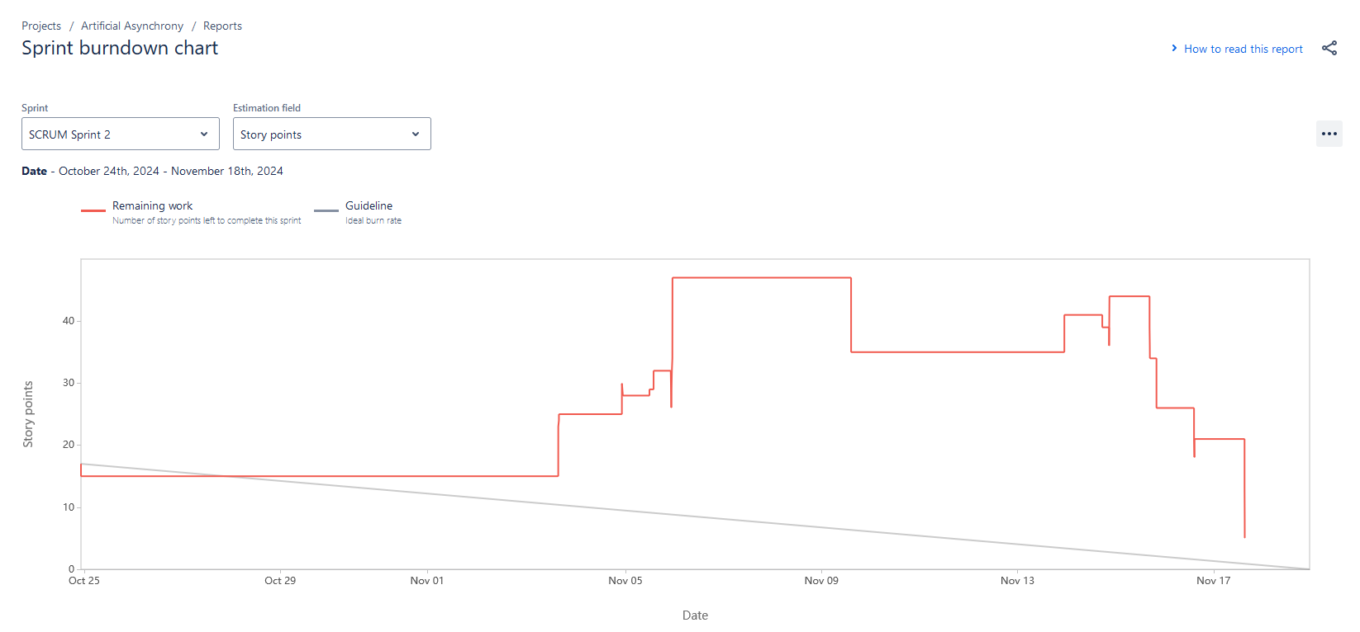
Metrics - Burndown
✅

Slide 46
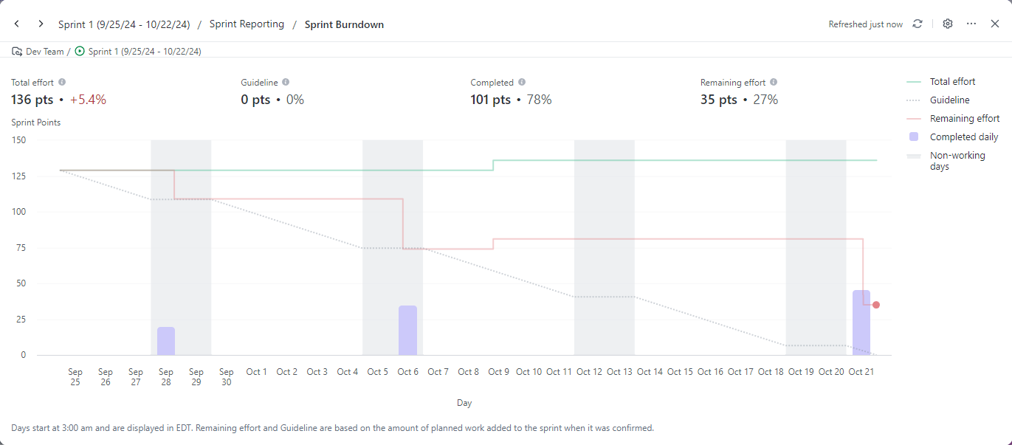
Metrics - Burndown History
✅

Slide 47
Metrics - Completion Ratio
✅
Committed | Completed | Ratio
50 | 45 | 90%

Slide 48
Metrics - Completion Ratio History
✅
Committed | Completed | Ratio
136 | 101 | 74%

Slide 49
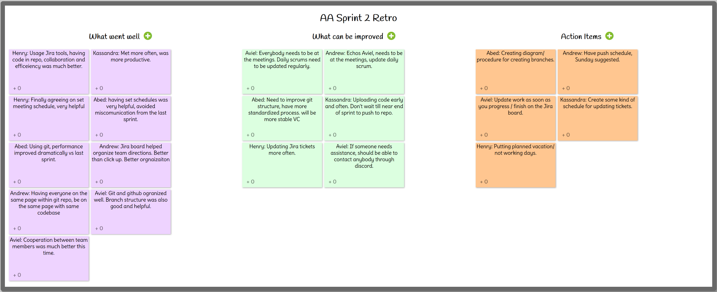
Sprint 2 Retrospective
✅
Notes:
Henry

Slide 50
Sprint 3 Stories
✅
Planned stories for Sprint 3
Roll over unfinished stories from Sprint 2
Notes:
Andrew

Slide 51
Sprint 3 Stories cont.
✅
Issue Type | Issue key | Summary | Assignee | Status | Description | Custom field (Acceptance Criteria)
Story | MARKETMAG-42 | View historical price data |  | To Do | *As a/an* retail investor, *I Want to* to see historical price data of a selected stock over a range of time I can specify, *So that* I can see price performance in that time range | # User can select an option to see historical data for a stock # The application allows the user to select a range of time # Application displays a line graph of price history within the time range
Story | MARKETMAG-43 | Save data visualizations |  | To Do | *As a/an* end user, *I Want to* save off displays and charts the applications has shown me, *So that* I can review them at a later time | # Application offers users an option to save the charts displayed to the user # User can choose to save it to their account or to their local environment

Slide 52
Sprint 3 Stories cont.
✅
Issue Type | Issue key | Summary | Assignee | Status | Description | Custom field (Acceptance Criteria)
Story | MARKETMAG-45 | Select the time window to train a stock model |  | To Do | *As a/an* retail investor, *I Want to* Select the time window to train a stock model, *So that* I can tailor the price predictions to my personal preferences | # Users can select a time range via slider bar or date range to train a stock model # The application displays the settings were saved for the model they are trying to train
Story | MARKETMAG-48 | Sort stock watchlist |  | To Do | *As a/an* retail investor, *I Want to* quickly sort and search through my watchlist based on price, trend, name, etc., *So that* I can easily see which stocks have been performing well/poorly quickly | # User can sort through their watchlist based on options provided by the application (such as current price, name, confidence)

Slide 53
Sprint 3 Stories cont.
✅
Issue Type | Issue key | Summary | Assignee | Status | Description | Custom field (Acceptance Criteria)
Story | MARKETMAG-61 | Create watch list page | Andrew Rowan | To Do | *As a* retail investor, *I Want* a webpage where I can add stock tickers to a watchlist, *So that* I can easily track my personal stock interests | # Users can navigate to a watchlist page when clicking on the watchlist link on the home page # Users can navigate back to the home page when clicking on the home page link on the watchlist page
Story | MARKETMAG-74 | Create sign up page |  | To Do | *As an* application user, *I Want* a sign up webpage, *so that* I can create a new user account | # When the user clicks on the sign up link, the browser should navigate to the sign up page # When the user clicks on the homepage link, the browser should navigate to the home page

Slide 54
Sprint 3 Stories cont.
✅
Issue Type | Issue key | Summary | Assignee | Status | Description | Custom field (Acceptance Criteria)
Story | MARKETMAG-76 | Add log out function |  | To Do | *As a/an* app user, *I Want to* log out from my account, *So that* other people can’t access my account | # When user clicks on the logout button, the application logs the user off # When logged off, user will be redirected back to homepage
Story | MARKETMAG-77 | Save stock to watchlist |  | To Do | *As a* retail investor, *I Want* to save a stock to my watchlist in the watch list page, *So that* I can customize and easily track my personal stock interests | # When user enters a valid stock symbol in the watchlist page, it is added to the user’s watchlist table.

Slide 55
Sprint 3 Stories cont.
✅
Issue Type | Issue key | Summary | Assignee | Status | Description | Custom field (Acceptance Criteria)
Task | MARKETMAG-78 | Improve Prediction Quality |  | To Do | *As a* Hedge fund manager*, I want* an application that can give me accurate and relevant prediction information*, so that* I can implement safer and more reliable trade and investment strategies that outperform traditional strategies | # When the user submits a request for a prediction, the user receives a predicted stock price, a graph displaying the predicted stock trajectory, and a risk level # When sharing prediction results, the user will also see how this prediction compares to traditional strategies
Story | MARKETMAG-83 | View watchlist contents |  | To Do | *As a* retail investor, *I Want* to save a stock to my watchlist in the watch list page, *So that* I can customize and easily track my personal stock interests | # When user clicks a view watchlist button, a table is presented to the user.

Slide 56
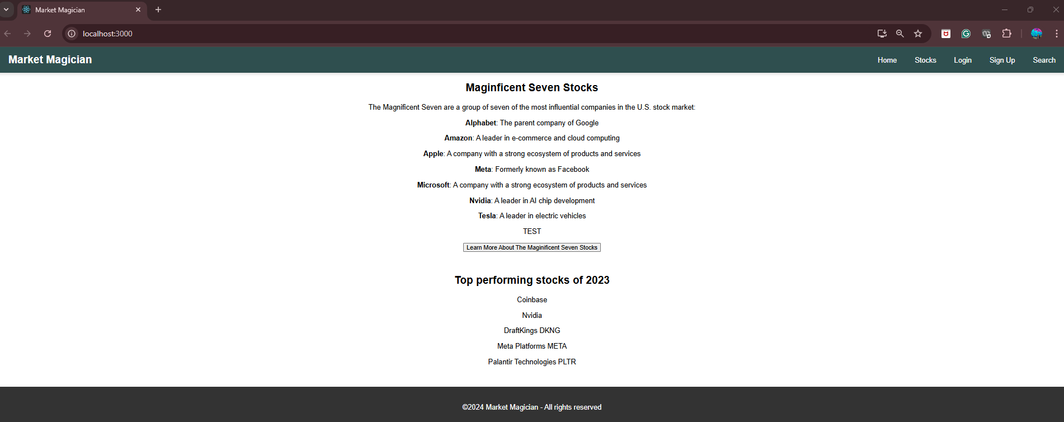
Project Demo 2
✅
Notes:
Kassandra

Slide 57
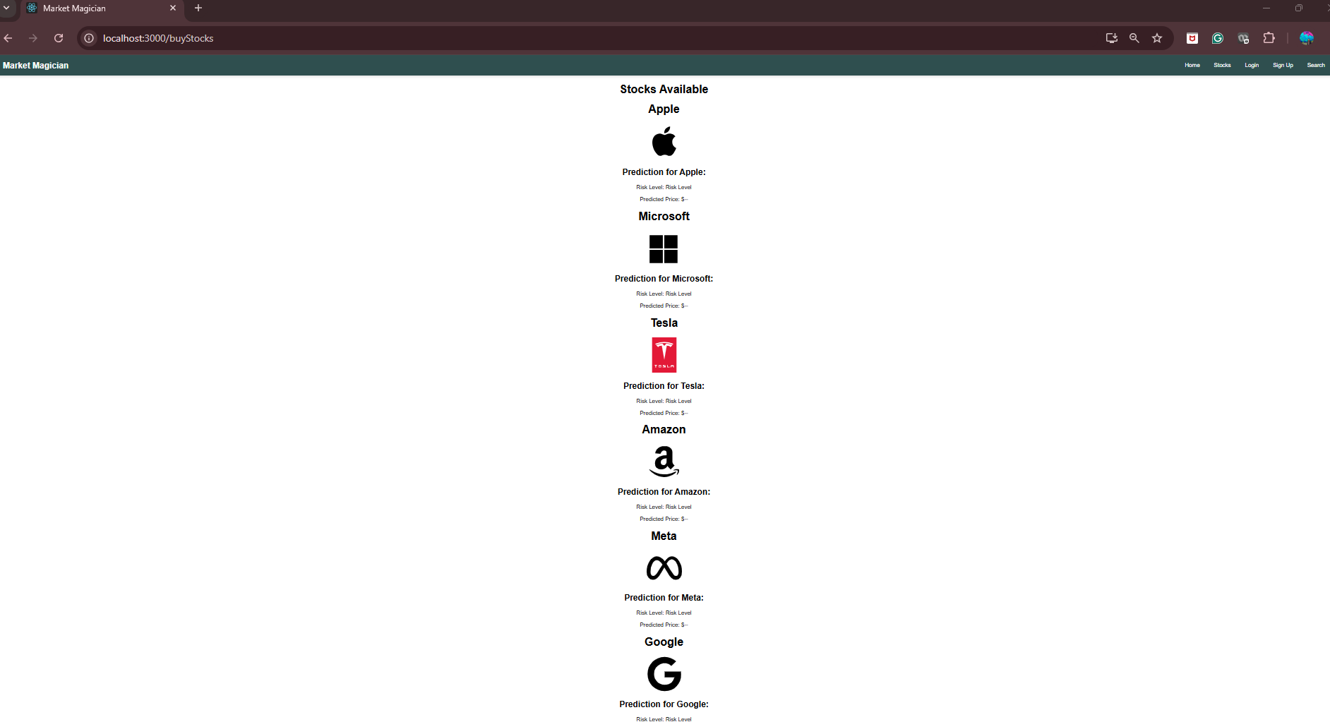
Project Demo 2
✅

Slide 58
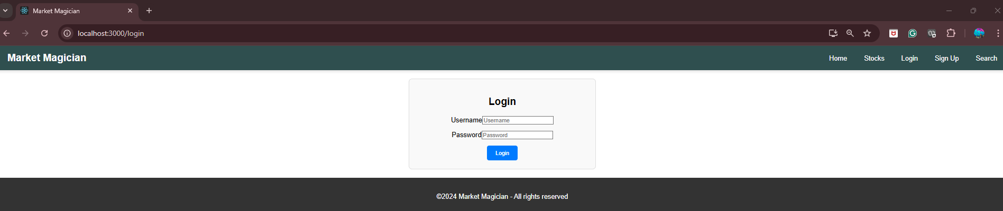
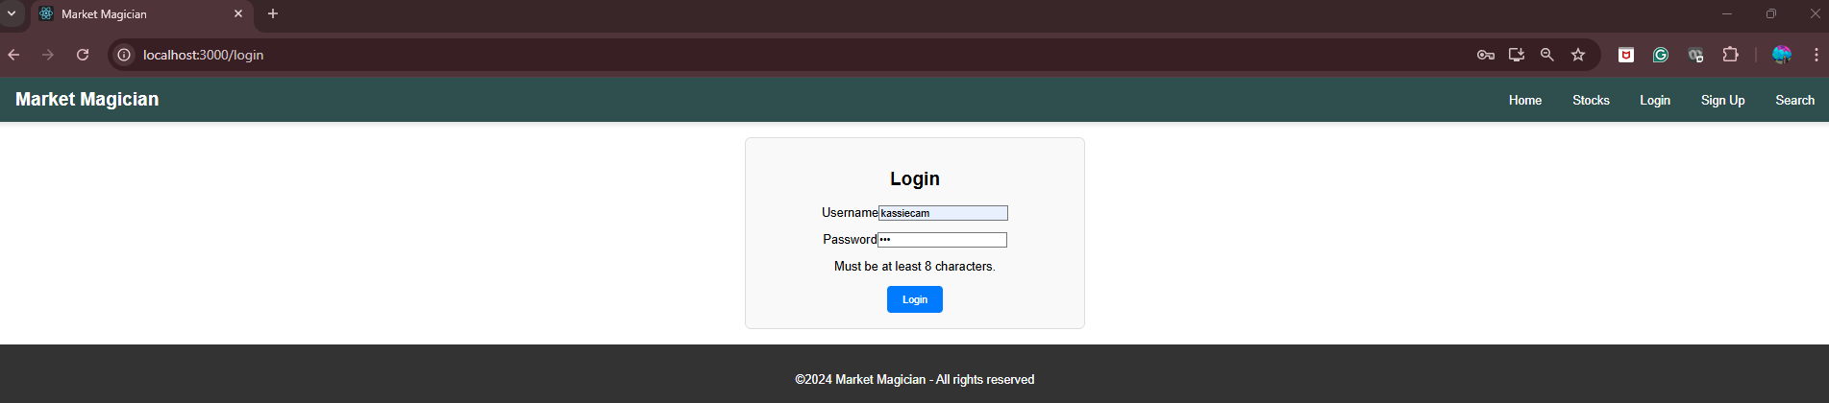
Project Demo 2
✅

Slide 59
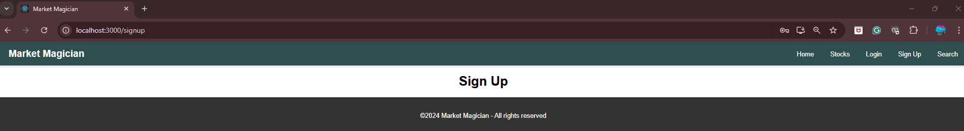
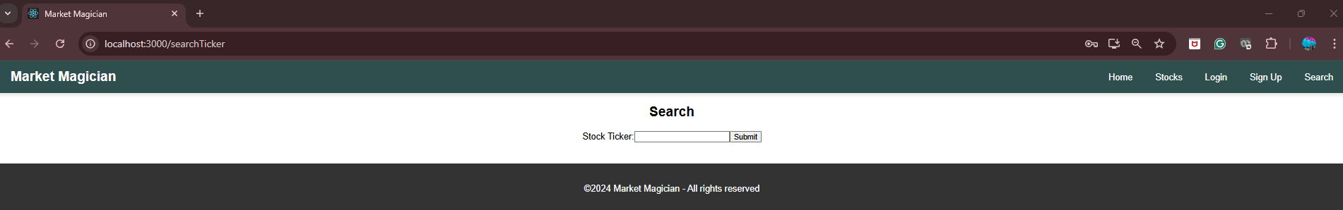
Project Demo 2
✅

Slide 60
Wikipage Link
https://github.com/htmw/2024F-Artificial-Asynchrony/wiki

